Slide 1

OneStopScholar
INFO6150 Web Design and User
Experience Engineering Fall 2022
Riya Patil
Ritvik Saxena
Souvik Dinda
Vinay Gudooru

Slide 2
Tech Stack
UI -
NextJS
SCSS
Backend -
Express
Node
DB - MongoDB
Authentication -
NextAuth
Session Storage
JWT

Slide 3
Purpose
With the problems and limitations associated with manual scholarship management procedures as witnessed in most today, complied with the problems associated with the existing application programs even much more in the presence of serious technological advances aimed at improving information system. This is activities aimed at shedding light upon the need for improvement in accounting activities and the means of achieving its efficiency, effectiveness, reliability and success promising future through computer intervention. Scholarship Management identifies a particular set of technological solutions for the development and the distribution of financial services, which rely upon the open architecture of the Internet. With the implementation of an Scholarship Management system, the Offices maintain a direct relationship with the end users via the web and are able to provide a personal characterization to the interface, by offering additional customized services.

Slide 4





Team Contribution
Souvik Dinda
Ritvik Saxena
Authentication
Email Validation
Scholarship Application Subbmision
Rest API – login data, student and sponsor profiling
UI/UX Design –
Dashboard
Scholarship
Student
Application APIs
Riya Patil
Vinay Kumar
Scholarship Approval/Denial
Scholarship Dashboard
Scholarship APIs
Dashboard
Sponser
Contact Validation
Registration form

Slide 5
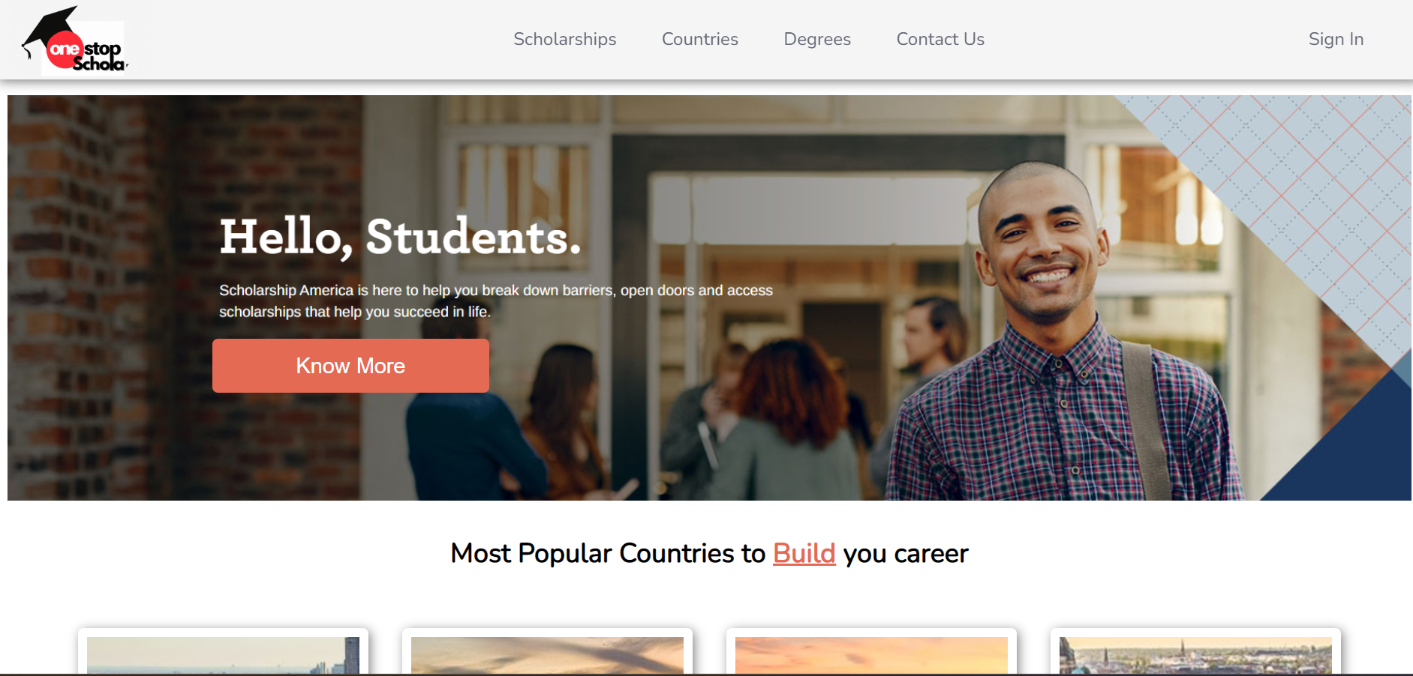
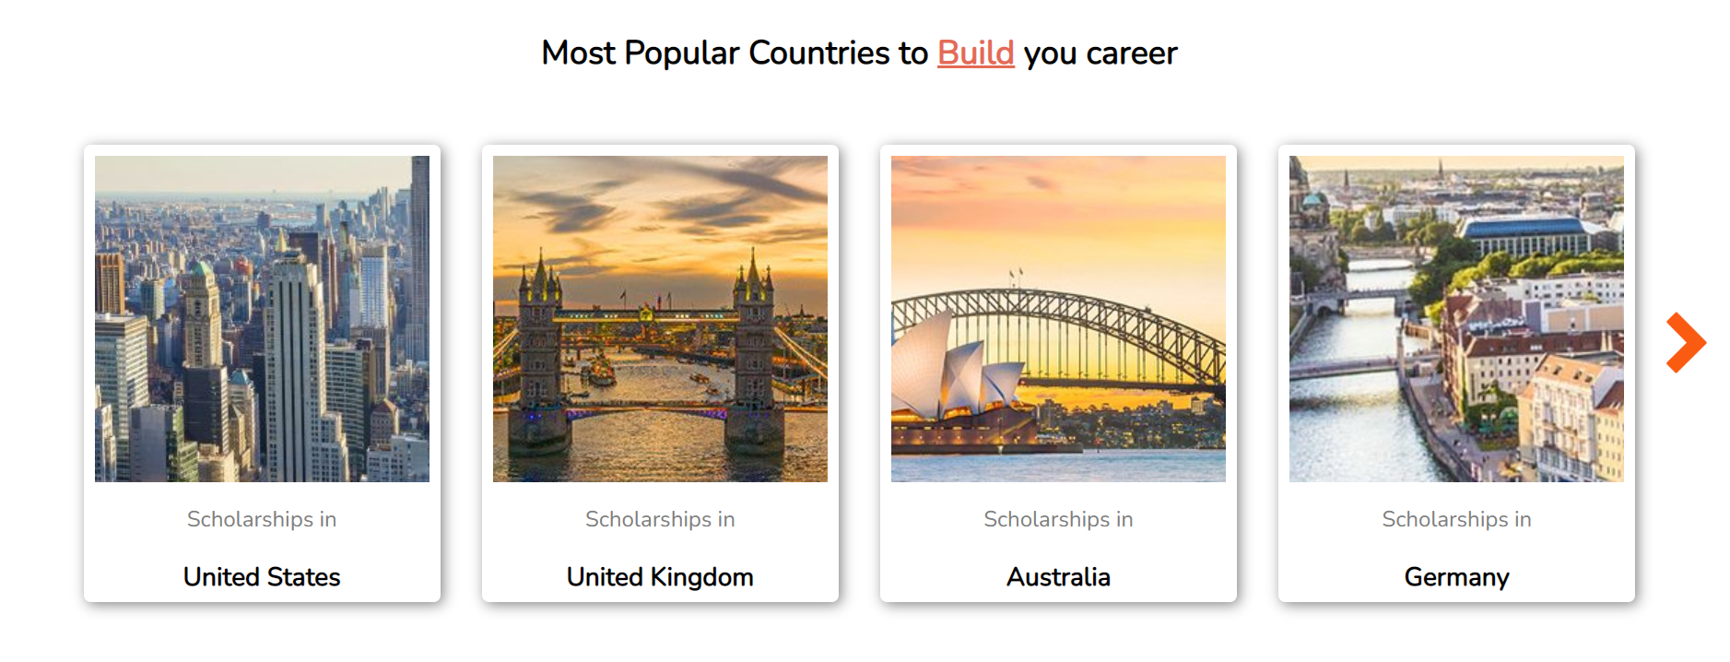
Website
Homepage

Slide 6
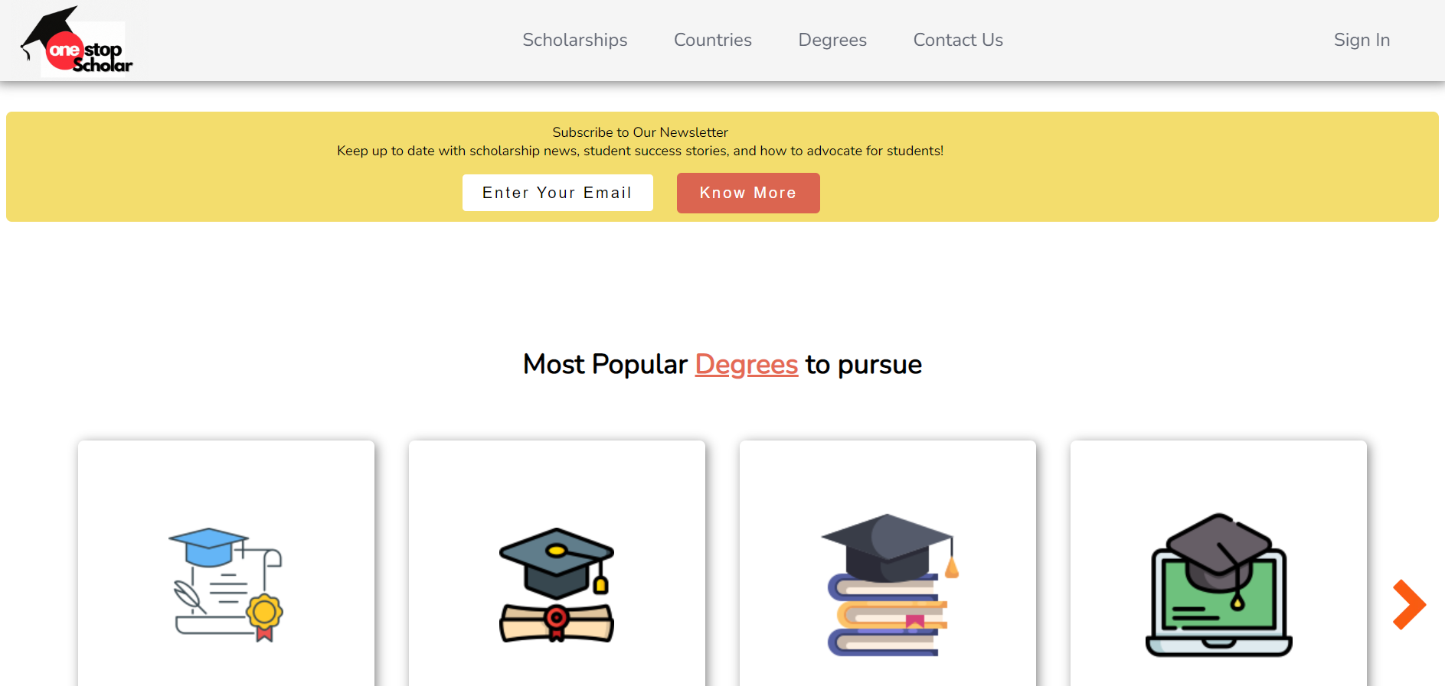
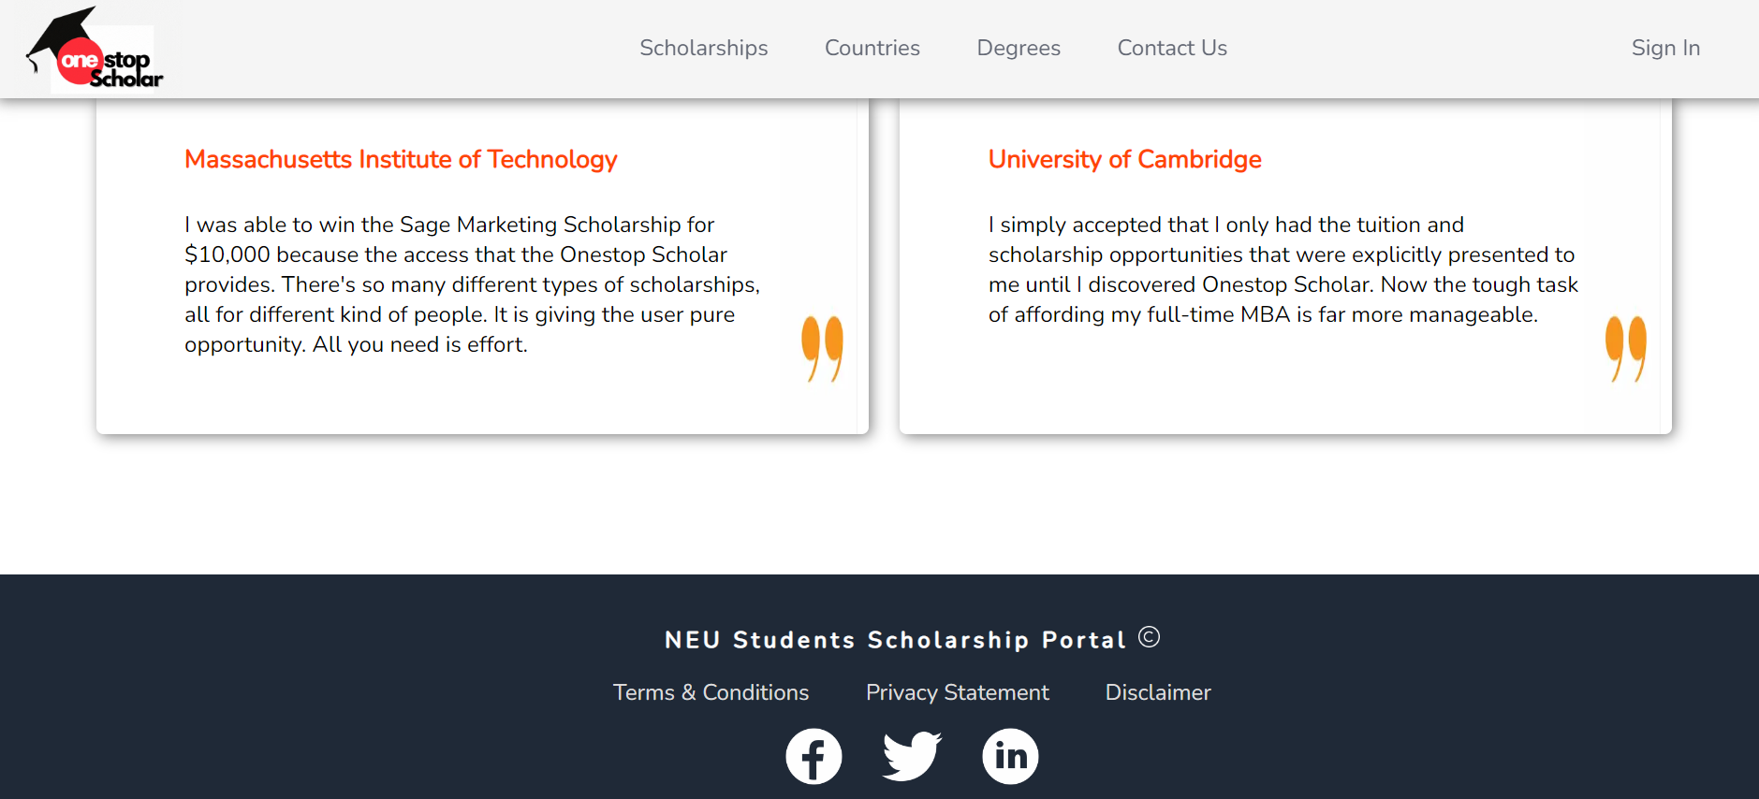
Website
Homepage

Slide 7
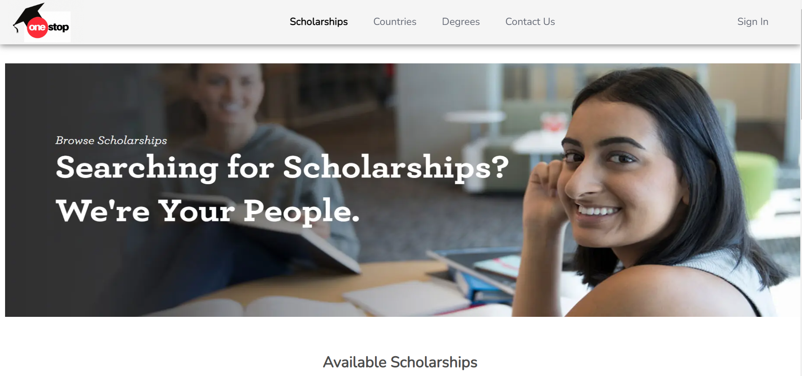
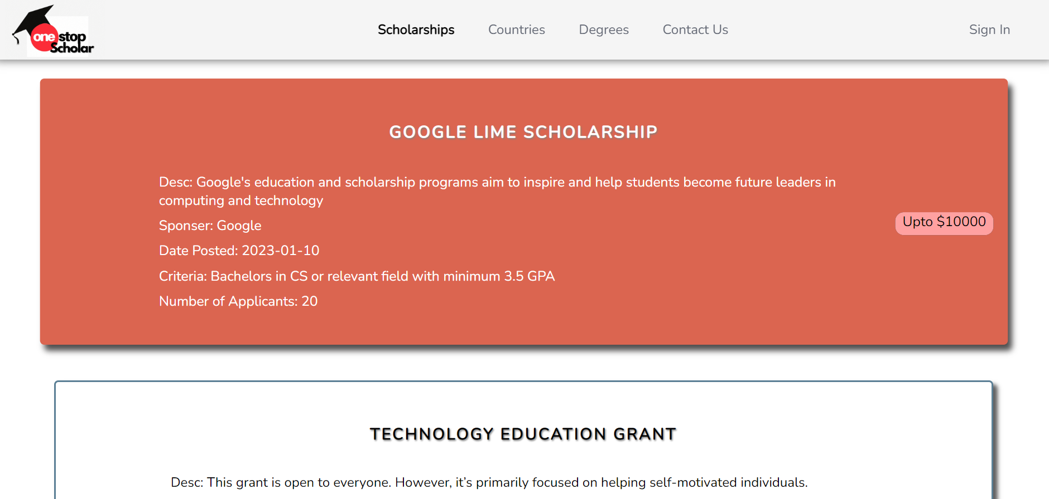
Scholarship
Dashboard

Slide 8
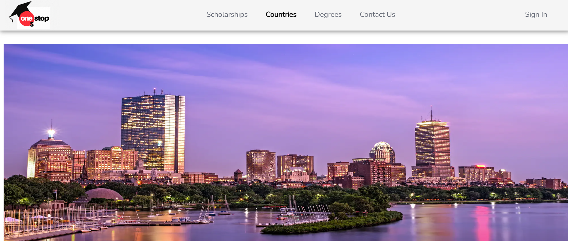
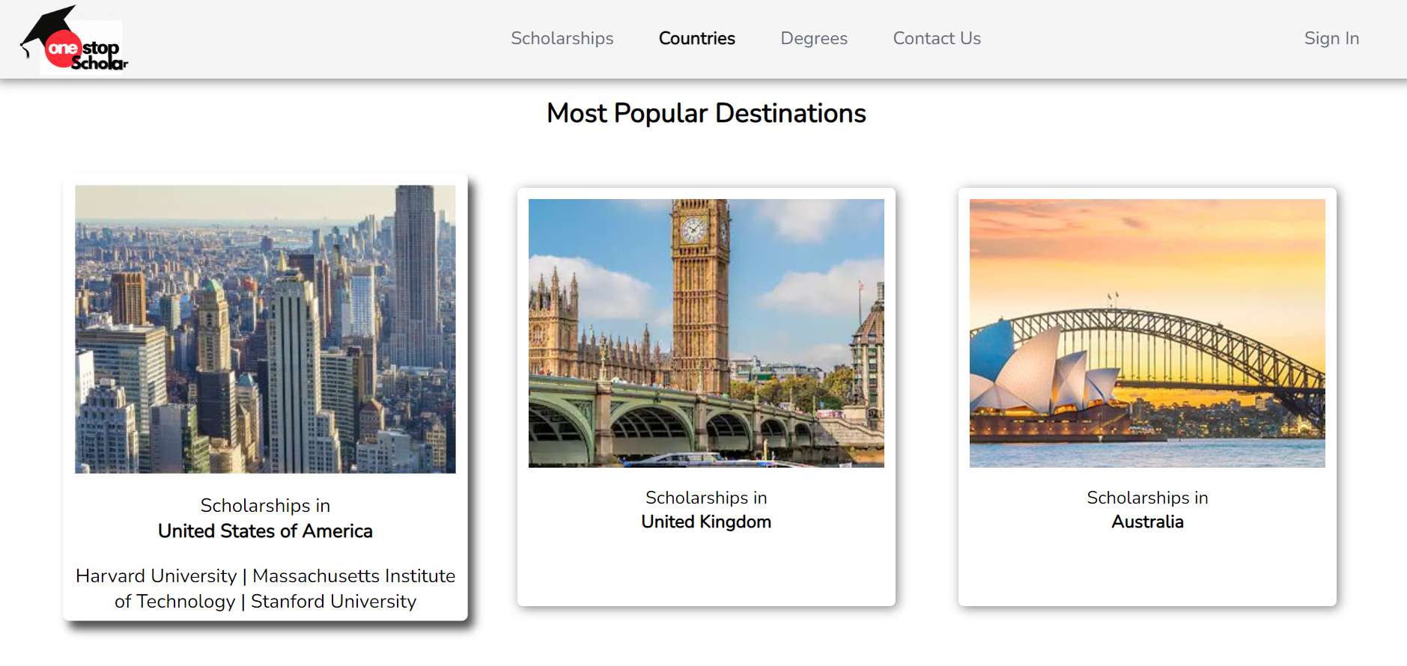
Countries
Dashboard

Slide 9
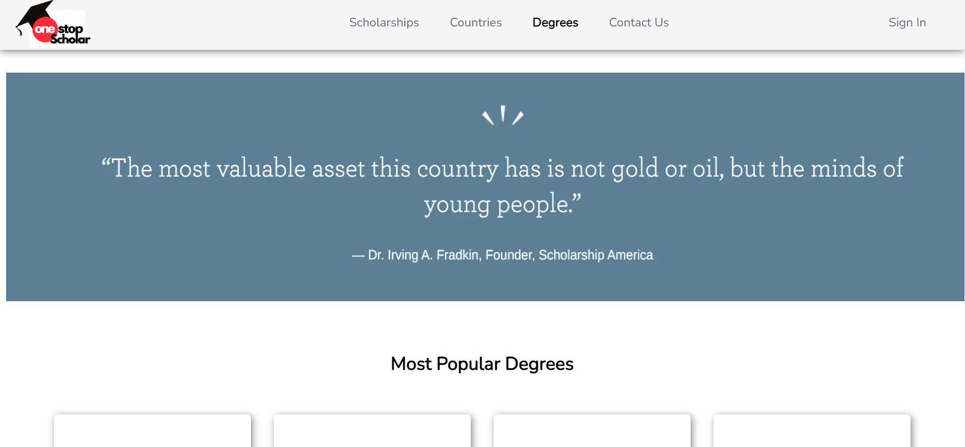
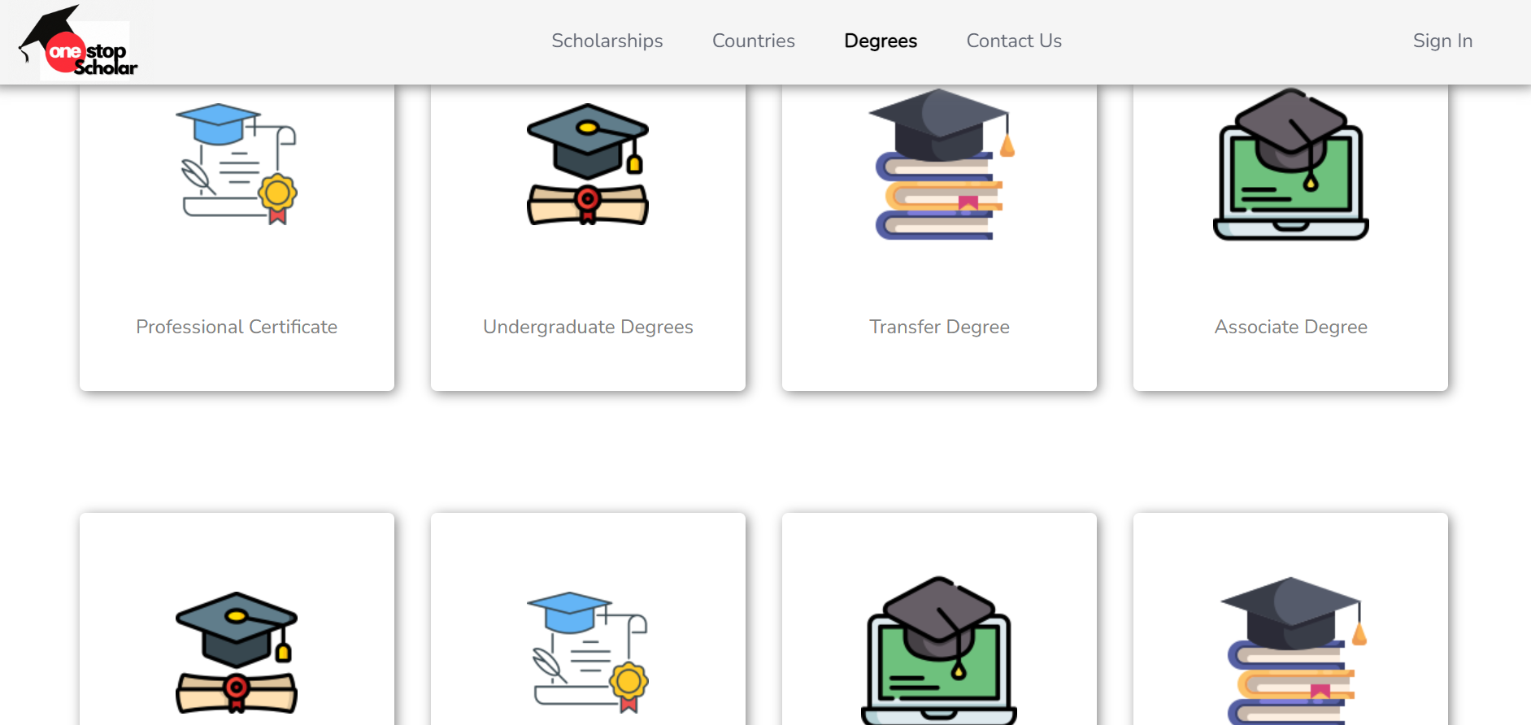
Degree
Dashboard

Slide 10
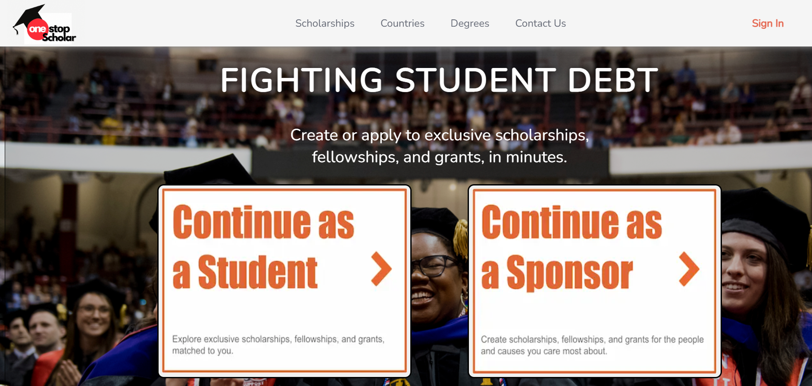
Sign In
Dashboard

Slide 11
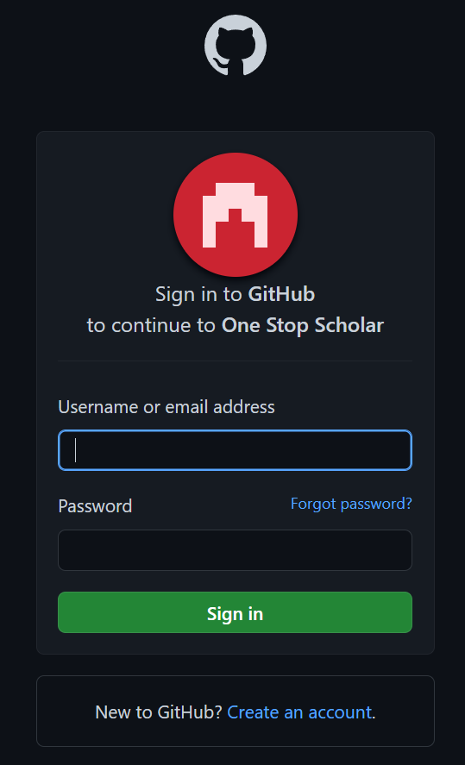
SignIn Dashboard
Via gitHub

Slide 12
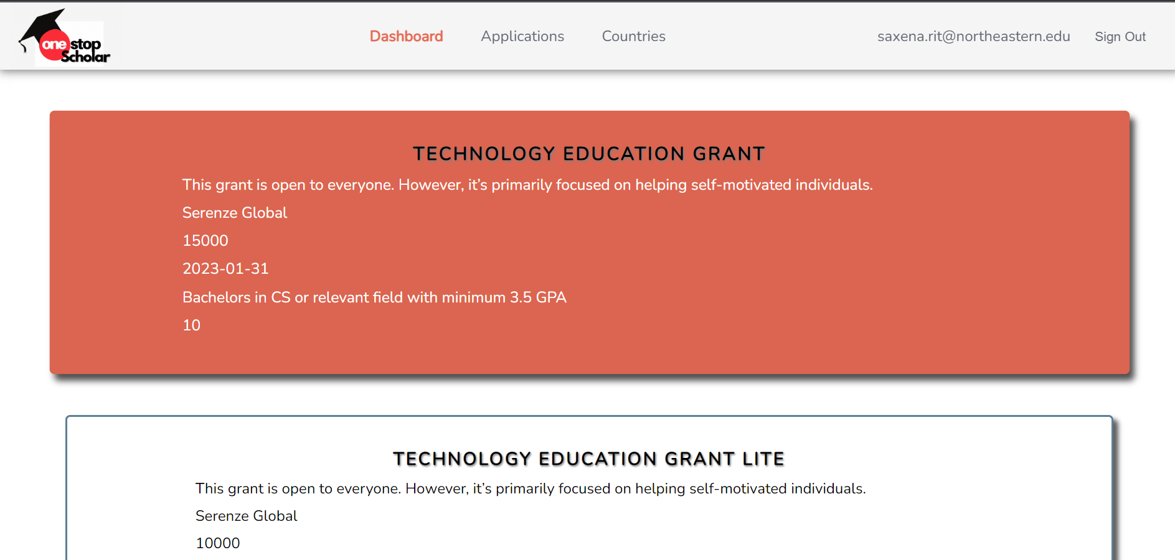
Student Dashboard
After Login

Slide 13
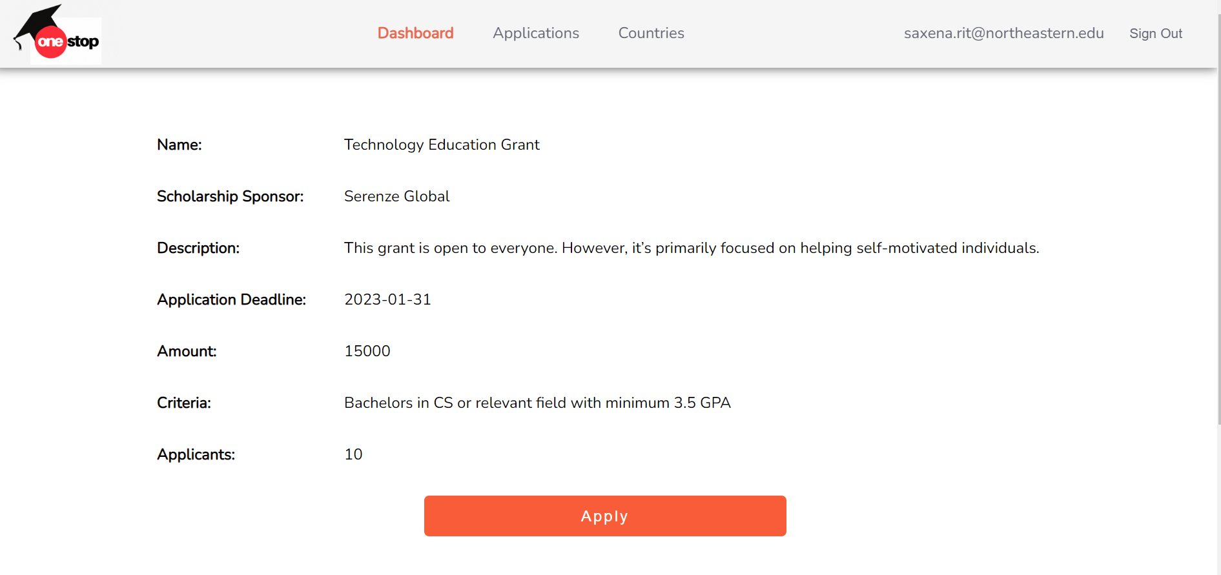
Student Dashboard
After Login

Slide 14
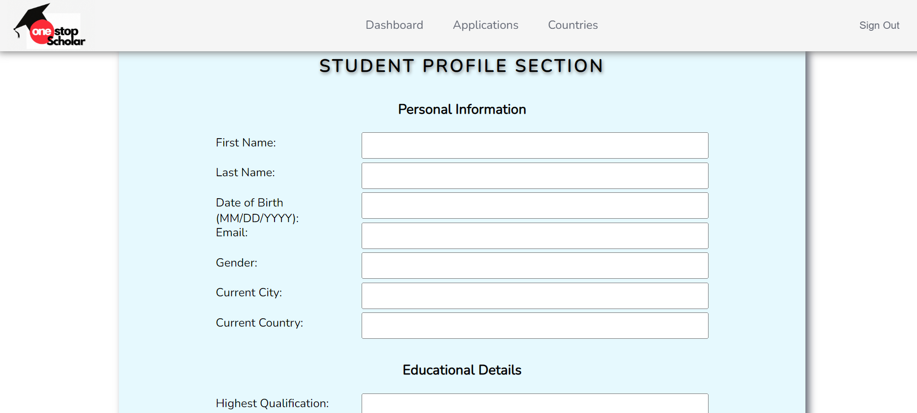
Scholarship Application
form

Slide 15
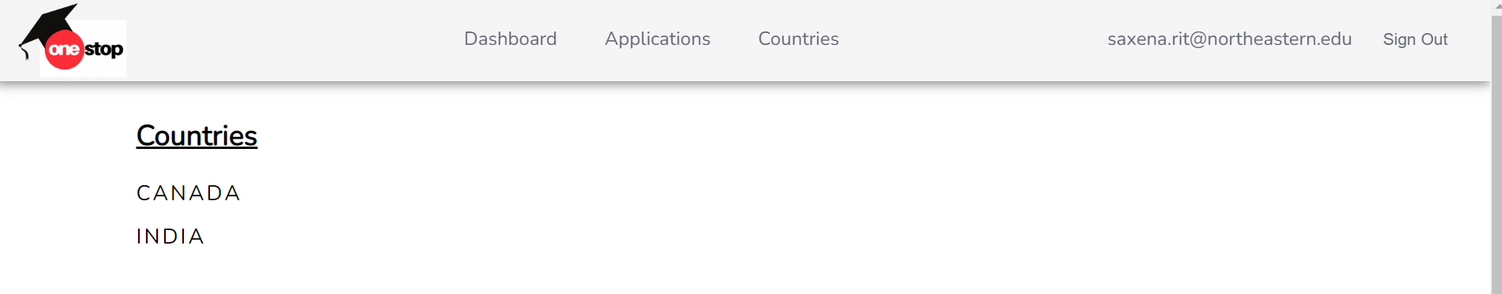
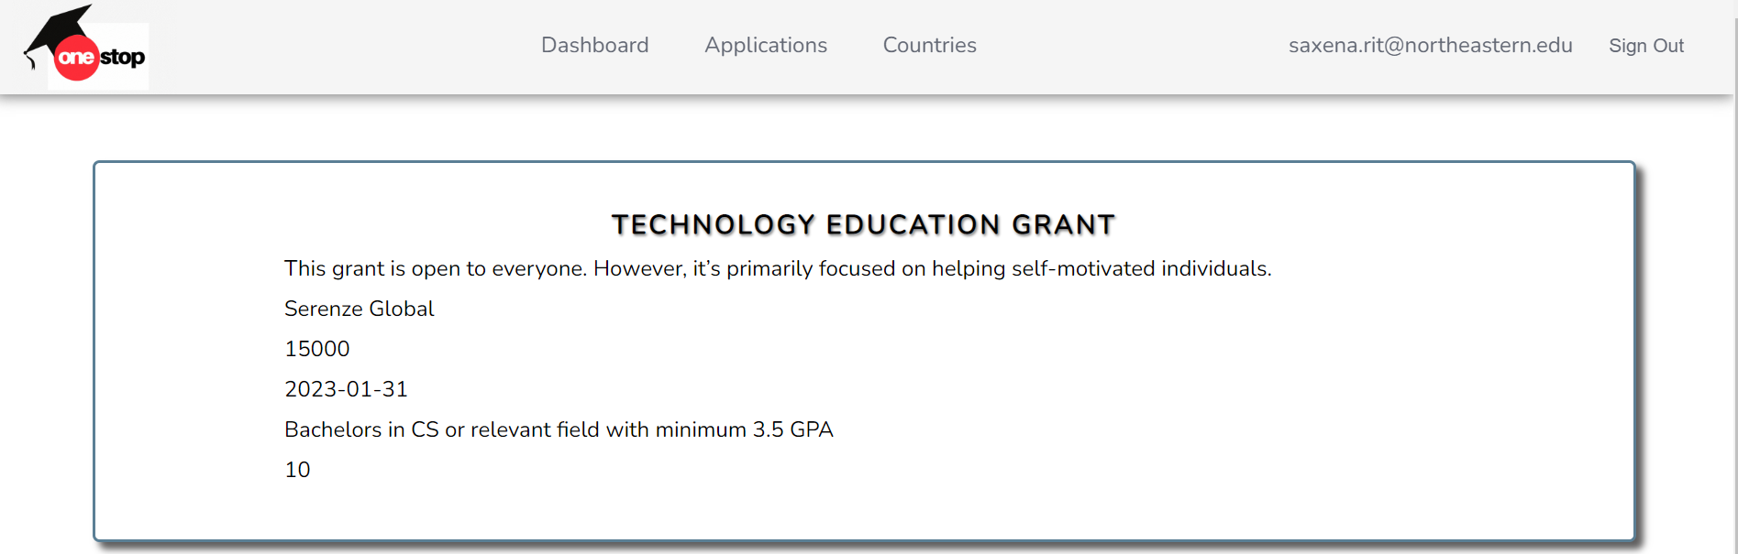
Country wise Scholarship

Slide 16
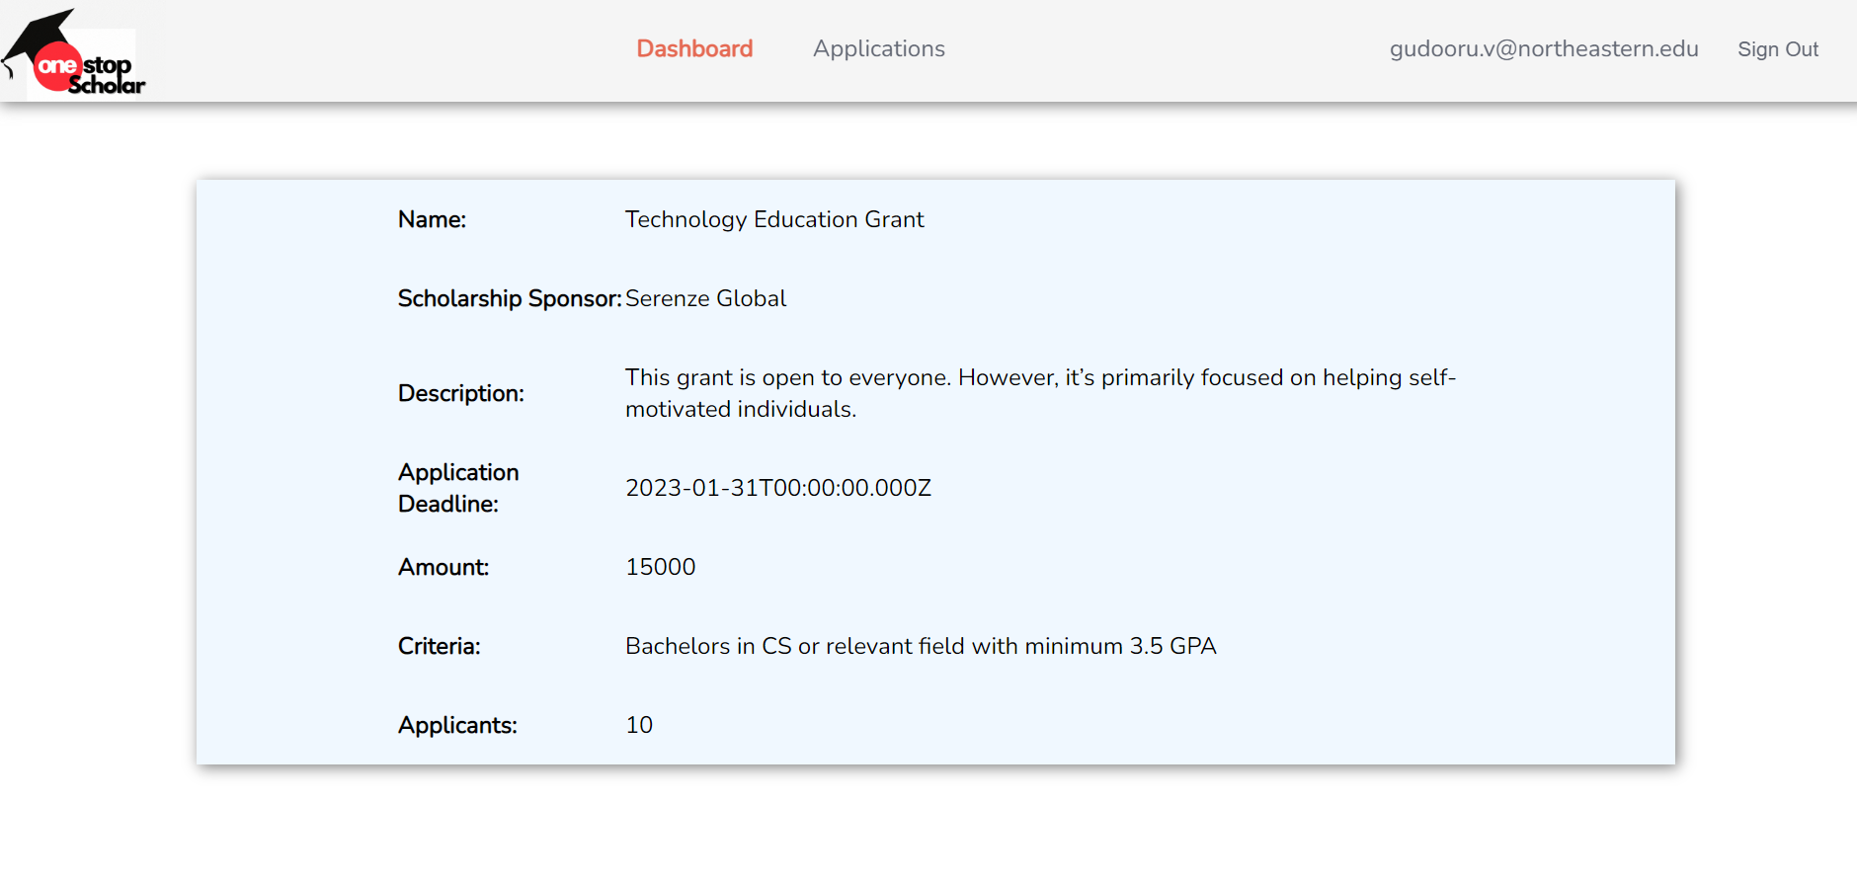
Sponsor
Dashboard

Slide 17
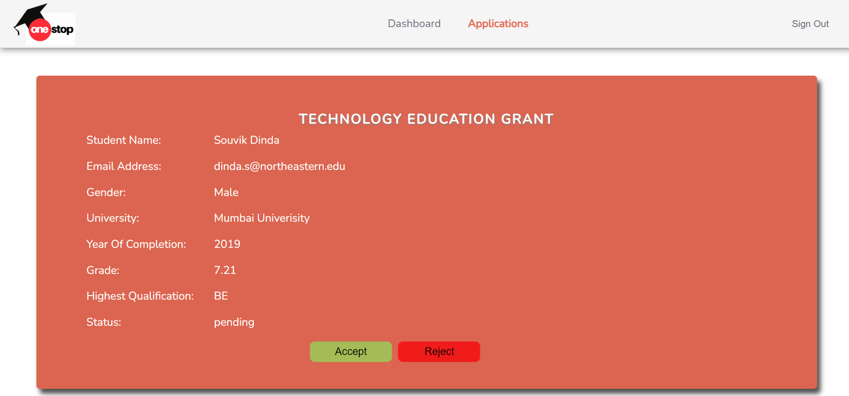
Sponsor
Application
Dashboard to accept or reject

Slide 18
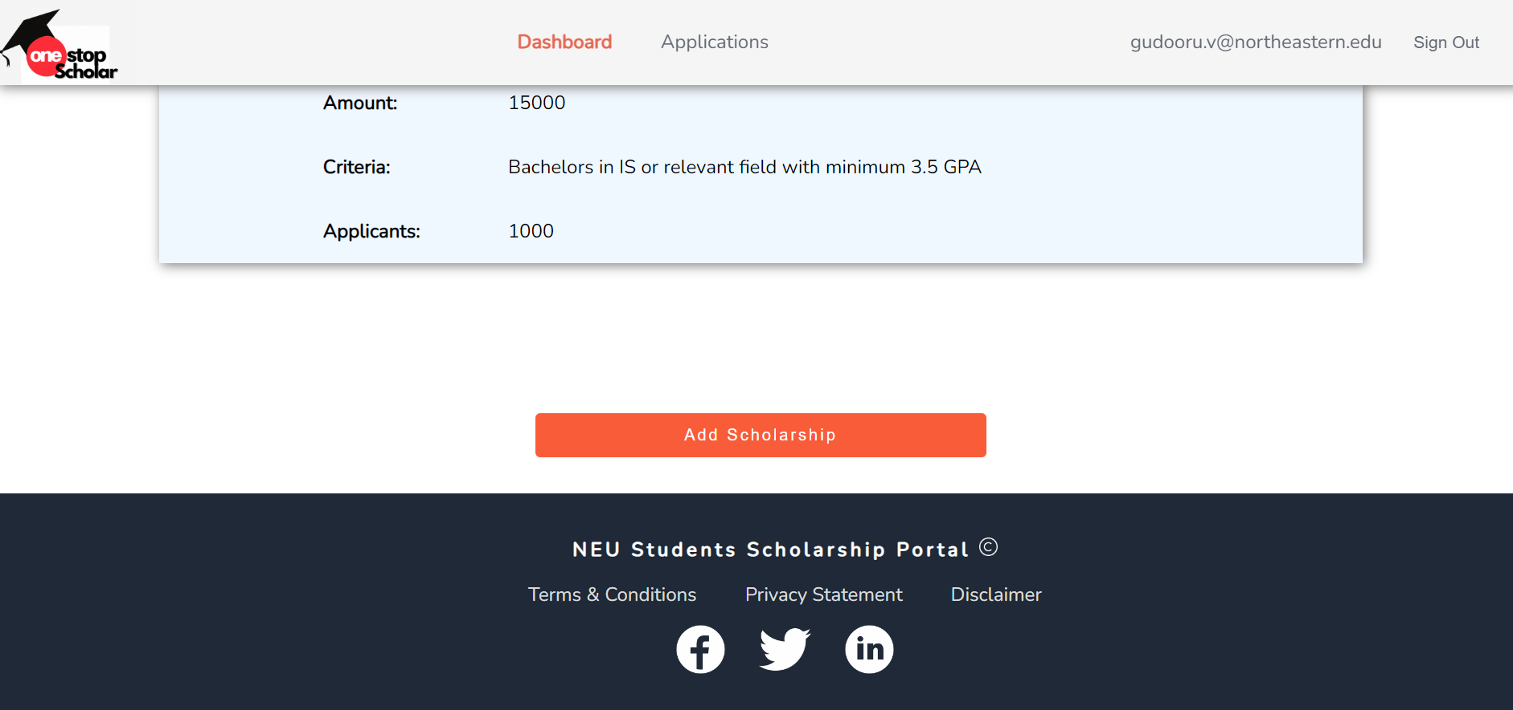
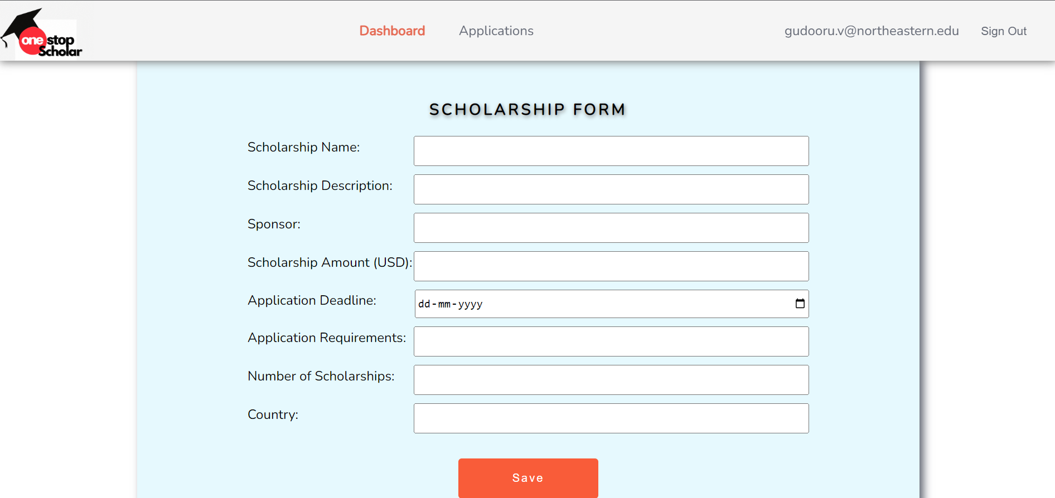
Sponsor
Can add new sponsership

